Slide 2
A short introduction to HTML

Slide 3

What is HTML
No seriously, what the hell is it?
HTML is text that explains to a computer:
What text should show up
What pictures to show
Which videos to show
You are going to learn to write HTML right now!
We’ll start with tags which are the fundamental building blocks of HTML

Slide 4
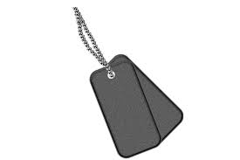
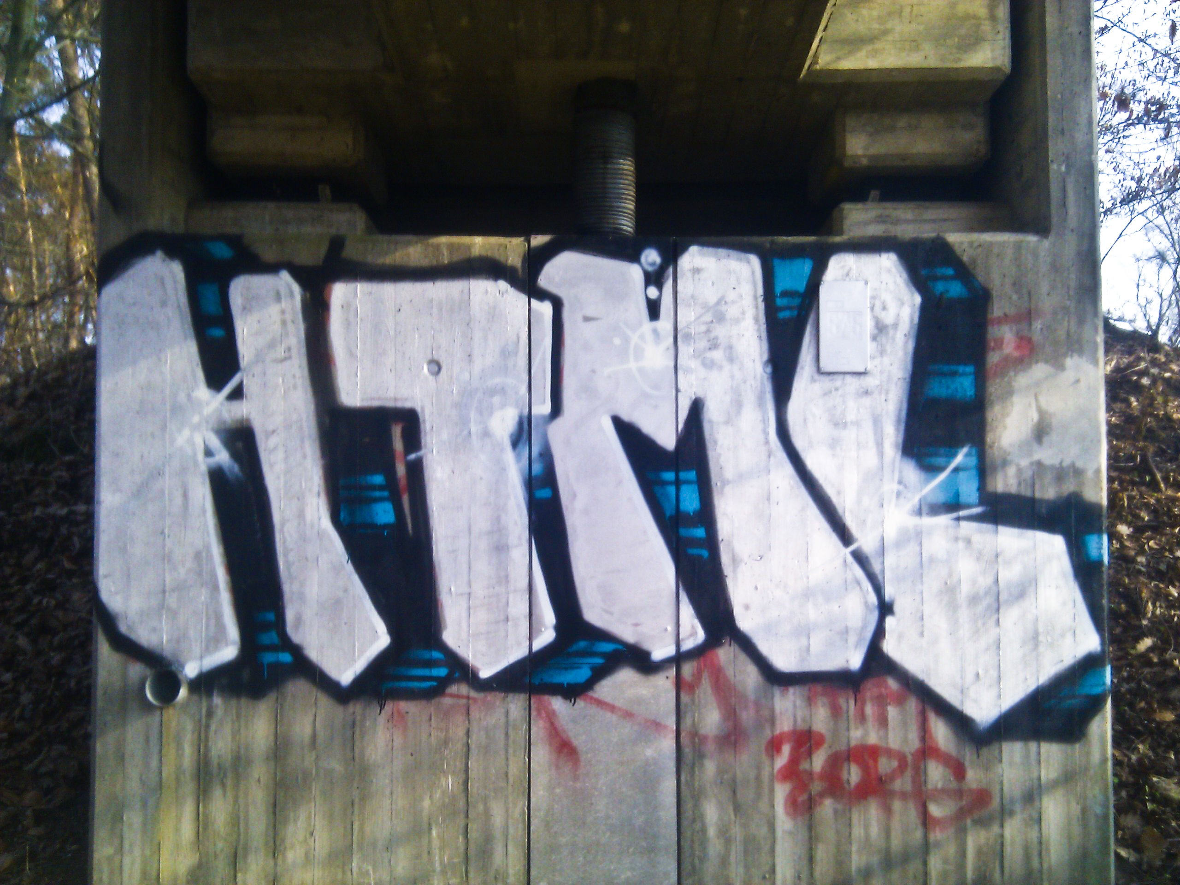


What are tags?
Tags are instructions that tell the computer what to do.
Not this
Close but not quite right
Definitely not this
Sadly not this either
Graffiti tag photo: Markus Tacker https://www.flickr.com/photos/tacker/7008647083

Slide 5
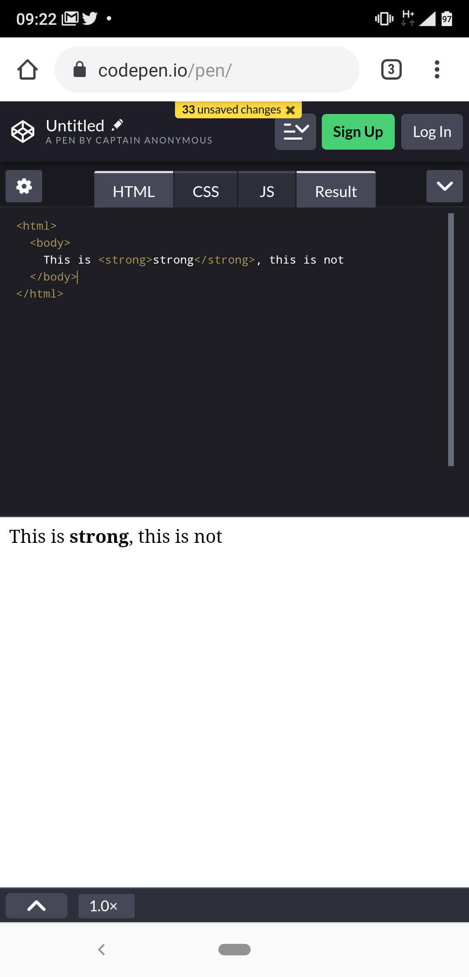
HTML Tags
And how to write them
You write this
Tags are a word or character wrapped in angle brackets
This is <strong>strong</strong>, this is not
<strong> tells the computer that everything that comes after this is going to be strong
</strong> tells the computer to making the text strong.
The browser (Chrome/Safari/Firefox) displays this

Slide 6
Ok let’s get started!

